Slide 1
Cloud Computing
Lecture 12
Transform IT to a Service

Slide 2
…How Will We Manage Our Data?
Manage it ourselves?
Personal, but time consuming.
How would you get access to your data wherever you are?
Would you keep it on your devices?
or would you keep it online?
What if it’s managed
by someone else?
and you can get this “service” for
free or with a subscription?

Slide 3




Has this Happened Before?
Innovation
Product
Service

Slide 4



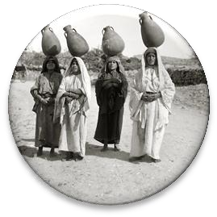
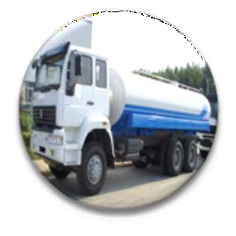
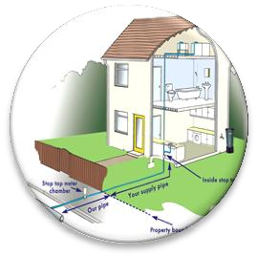
Think of it this Way …
Evolution of water Utility
Get a continuous supply of the utility through a dedicated connection
Generate your own
utility
Buy it as a product and
manage it

Slide 5




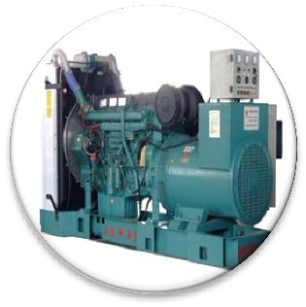
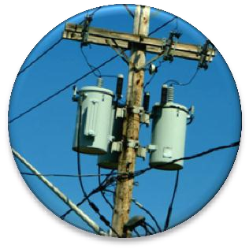
How About Electricity?
Transformation from a Product to a Service
Innovation
New Disruptive Technology
Product
Buy and Maintain the Technology
Service
Electric Grid, pay only for the electricity you use

Slide 6




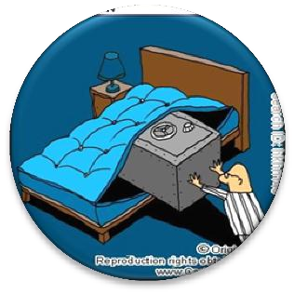
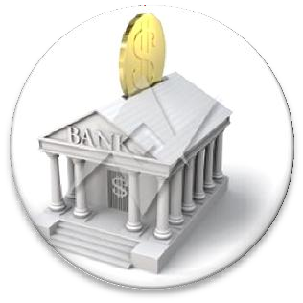
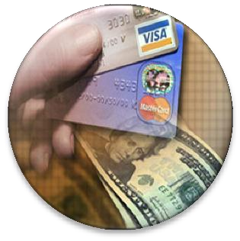

…and Banking?
Evolution of Banking
No Banks
(Take care of your own money )
Traditional
Banking
(Give your money to the bank)
Banking
Instruments
(Cheques / Credit Cards)
Internet Banking
(…more services)

Slide 7
So What is Cloud Computing?

Slide 8

Can We Define Cloud Computing?
“Cloud Computing is the transformation of IT from a product to a service”
Innovation
Product
Service

Slide 9


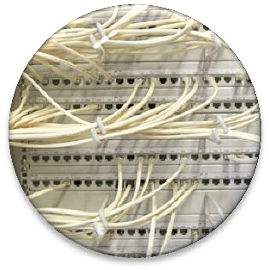
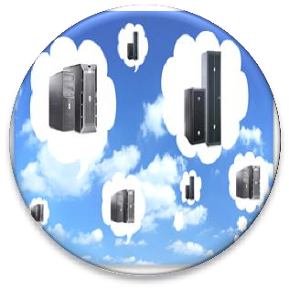
Cloud Computing
Transformation of IT from a Product to a Service
Innovation of IT
New Disruptive Technology
IT Products
Buy and Maintain the Technology
Cloud Computing
On-Demand IT services on a Pay-as You-Go basis

Slide 10
So… how would you transform information technology into a Service?

Slide 11

Requirements to Transform IT to a Service
Connectivity
For moving data around
Interactivity
Seamless interfaces
Reliability
Failure will affect many people, not just one
Performance
It should not be slower or less efficient than what people already have
Pay-as-you-Go
Should not pay an upfront
fee for the service
Ease of Programmability Ease of development of complex services to users
Manage Large Amounts of Data
Big Data
Efficiency
Cost Power
Scalability & Elasticity Flexible and rapid response to changing user
needs

Slide 12

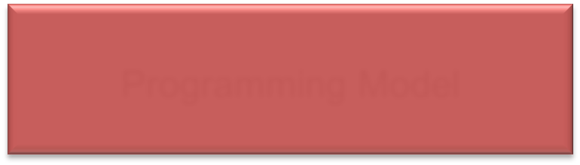



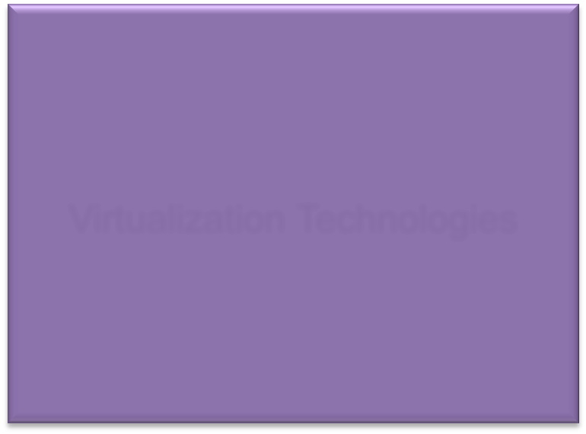
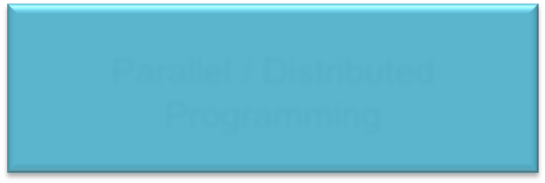
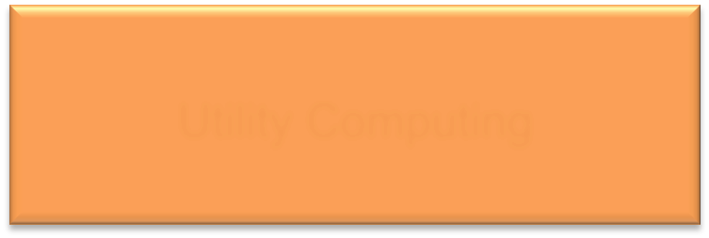
Requirements to Transform IT to a Service
Connectiv_{In}it_{te}y_{rnet}
For moving data around
Interactiv_{W}ity_{eb 2.0}
Seamless interfaces
Reliability
Fault-Tolerance
Performance
Parallel / Distributed
Programming
Pay-as-you-Go Sho_{U}u_{ti}l_{l}d_{ity}n_{C}ot_{om}pa_{p}y_{ut}a_{in}n_{g} upfront fee for the service
Ease of Programmability
Programming Model
Manage Large Amounts of DaSttoarage Technologies
Big Data
Efficiency
Cost Power
^{Sc}Vªir^{la}tu^{b}al^{i}iz^{li}a^{ty}tio&n T^{E}ec^{la}hn^{s}o^{t}l^{i}o^{c}g^{it}ie^{y}s Flexible and rapid response to changing user
needs
Ease of development of complex services to users
Failure will affect many people, not just one
It should not be slower or less efficient than what people already have.

Slide 13
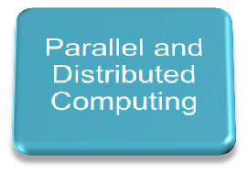



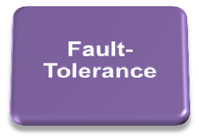
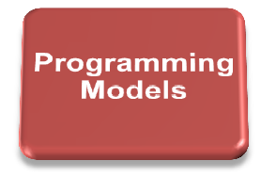


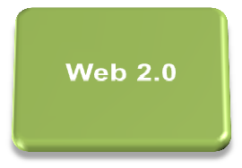
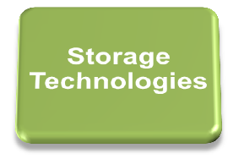
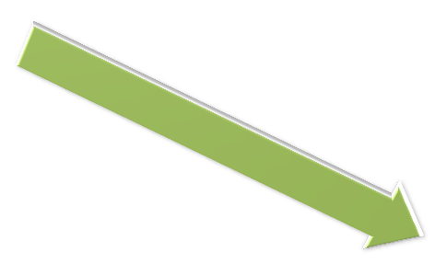
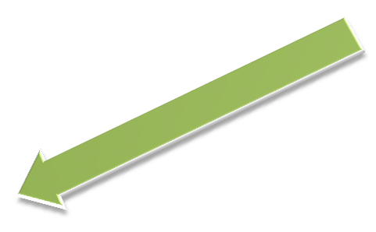
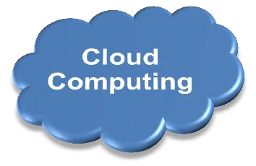

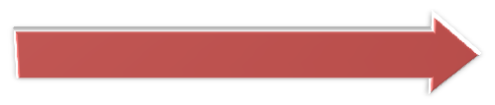
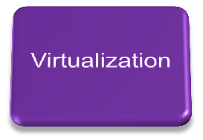

Combine the Enabling Technologies…

Slide 14


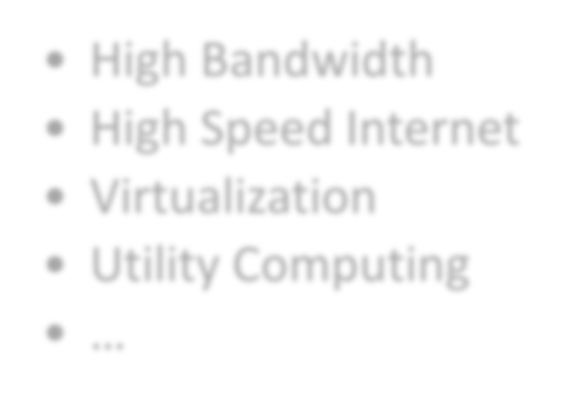
Cloud Computing
Think of it as Internet Computing
Computation done over the Internet
High Bandwidth
High Speed Internet
Virtualization
Utility Computing
…
Enabling Technologies
Cloud Computing

Slide 15
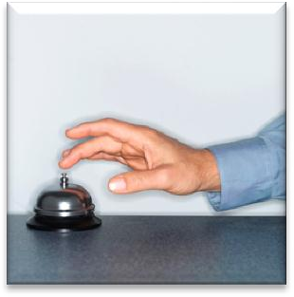


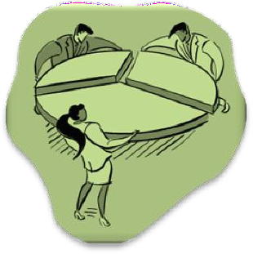
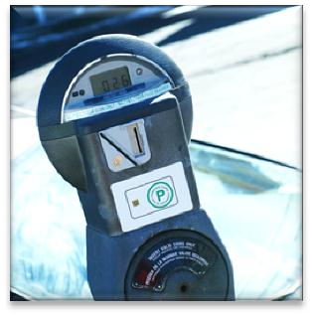

… for a more complete definition!
Cloud Computing is the delivery of computing as a service rather than a product,
whereby shared resources, software, and information are provided to computers and other devices,
as a metered service over
a network.

Slide 16












Why Cloud Computing?
Pay-as-You-Go
economic model
Reduce capital expenditure
No upfront cost
Reduced Time to Market
Simplified IT
management
All you need is access to the internet.
It’s the providers responsibility to manage the details.
Scale quickly and effortlessly
Resources can be rented and released as required
Software Controlled
Instant scalablility
Flexible options
Configure software packages, instance types operating systems.
Any software platform
Access from any machine connected to the Internet
Resource Utilization is improved
Reduce Idle resources by sharing and conolidation
Better utilization of CPU / Storage and Bandwidth.
Carbon Footprint decreased
Sharing of resources means less servers, less power and less emissions.

Slide 17


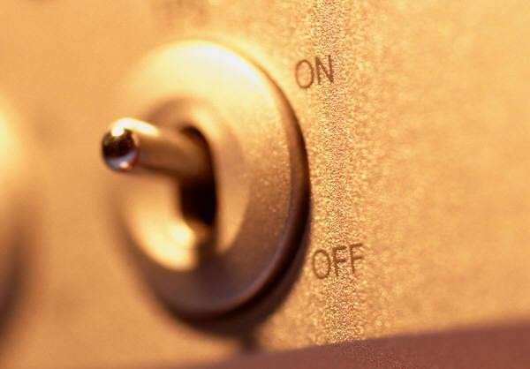
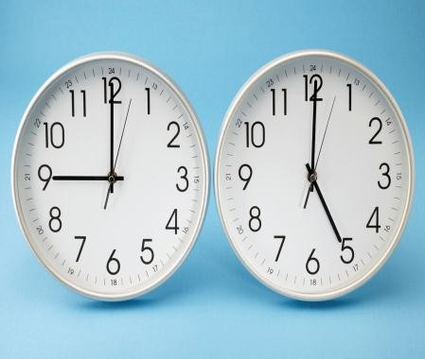
Applications Enabled by Cloud Computing
High Growth Applications
Aperiodic Bursting Applications
Startup Businesses
Seasonal Bus
inesses
On-Off Applications
Periodic Applications
Research Computing
Changing computational patterns over time

Slide 18


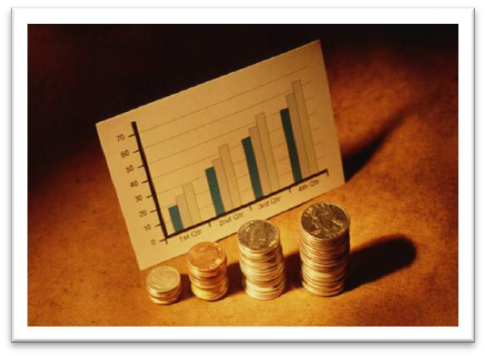
High Growth Applications
2001
2006
vs.
Could not keep up with the growth of their number of users.
Growing exponentially
What do you do when your startup gains traction?
Can you grow quick enough?

Slide 19
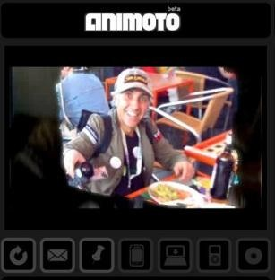
High Growth Applications
Animoto’s Facebook Plugin doubled traffic to the
site every 12 hours for 3 days.
They could scale from 50 servers to 3500 and go
back down using cloud computing services
Users use it to produce video pieces from their photos, video clips and music.
What do you do when your startup gains traction?
Can you grow quick enough?

Slide 20




Aperiodic Bursting Applications
Website went down on 9/11/2001 due to traffic
February 14th – Busiest Day of the Year US Holiday Season
Website crashed within 10 minutes of the free trouser
promotion during Superbowl 2010
Even if you design your website infrastructure to handle
peak loads, wont it be idle during other times?

Slide 21
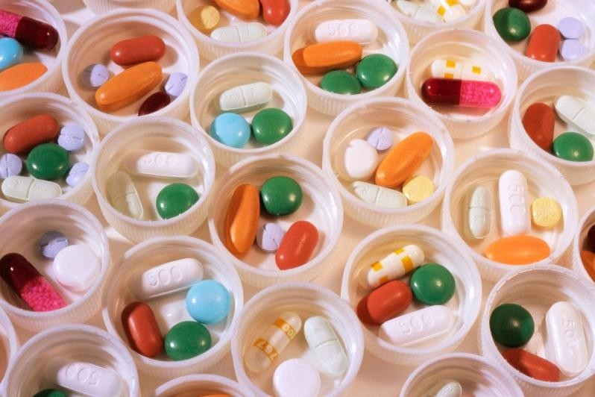
On-Off Applications
Researchers running large-scale scientific simulation using 1000s of computers.
Modern Drug Discovery
Data-intensive simulation and tests to discover new compounds
Large compute power required for simulation jobs
Time to market is crucial
Why not rent computer time to run
these simulations?

Slide 22
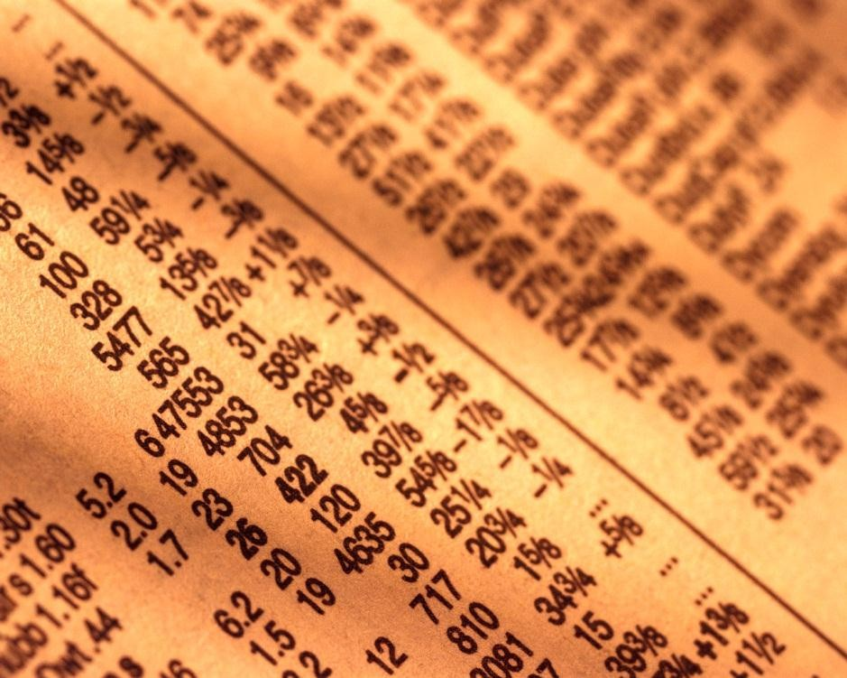
Periodic Applications
Sock Market Analysis
Different compuational requirements
over time
Mine market data during the day.
Process and Analyze at night.
Dynamic and Flexible infrastructure can
reduce costs and improve performance.

Slide 23
Technical Challenges
Programming is tricky but improving Tools are continuously evolving Moving large data is still expensive Security
Quality of Service Green computing Internet Dependence

Slide 24
Non-Technical Challenges
Vendor Lock-In Non-standardized Security Risks Privacy
Legal
Service Level Agreements

Slide 25
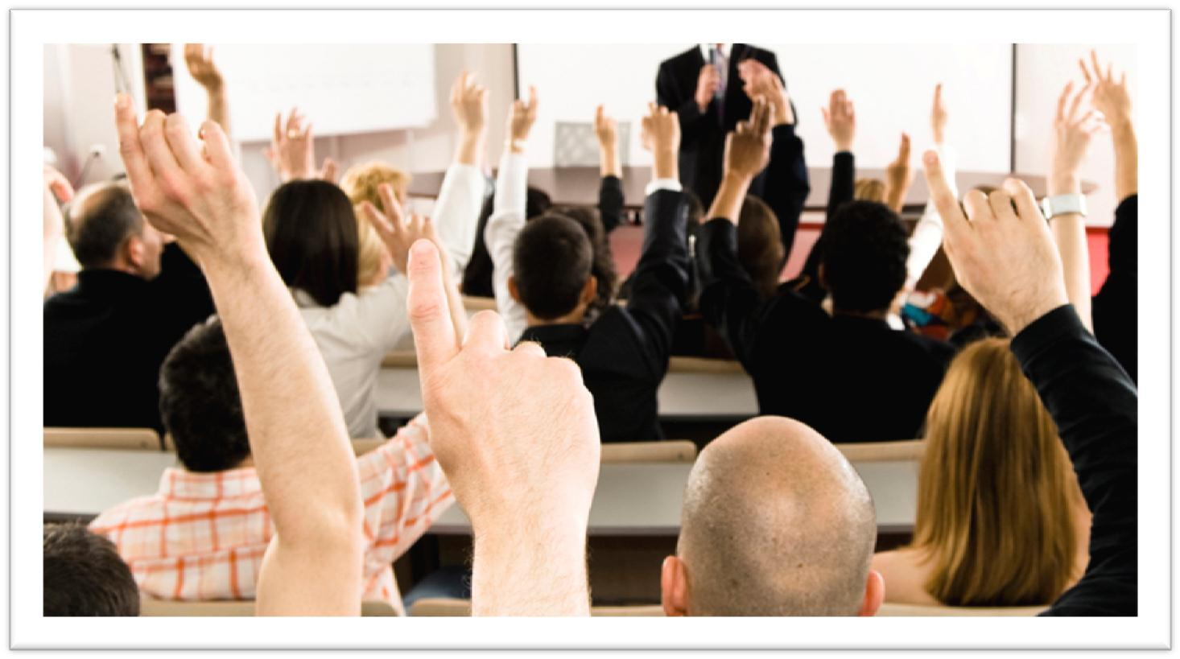
Questions?

